Slide 1
Welcome Bystander Training

Slide 2
Acknowledgement of Country Gippsland Women's Health and the East Gippsland Primary Care Partnership acknowledge the traditional custodians of the land on which we gather today. We recognise and respect the cultural heritage of the Aboriginal and Torres Straight Islander peoples, their beliefs and close relationship with these lands. We pay respects to the elders of the community, past present and emerging and we thank them for their contribution to health services across East Gippsland

Slide 3
Introductions
We are:
Glenn Bury
Marilyn Manukia
You are?

Slide 4
House Keeping
Toilets
Breaks
Safety and self care

Slide 5
What to Expect Today
Leadership
Bystanders
Who are they? What can they do?
ADU Statements
Language and Jokes
Gender stereotypes
The Iceberg
Wrap up and Evaluation

Slide 6
Leadership

Slide 8
Bystanders
Who are they?
What Can They do?

Slide 9
There are always three sides to gender based violence
Victim
Bystander
Perpetrator

Slide 11
Scenario

Slide 12
Direct
Physically intervening
Verbally intervening
Potential for high risk

Slide 13
Indirect
Calling Police
Calling emergency services

Slide 14
Distract
At a proximal or distal level
Serves to diffuse and de-escalate
Not necessarily addressing the issue specifically
Low risk
Does not address the broader problem

Slide 15
Protocol
Policies and Procedure
Induction to workplaces
State and Federal legislation
Assist in making choices
Are pre-established and recognised
Are influenced by leadership

Slide 17
Break

Slide 18
Objectification of women

Slide 19
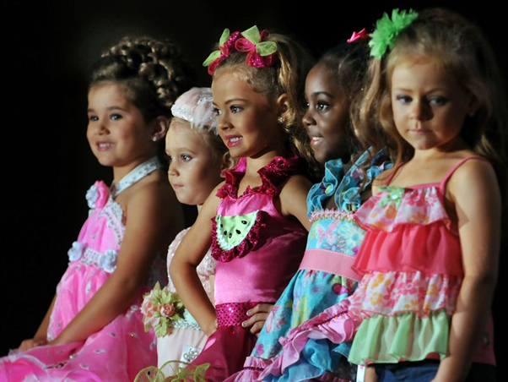

Slide 21
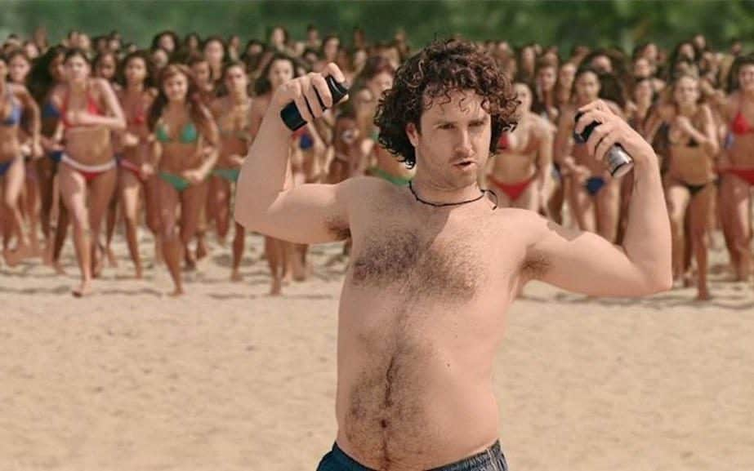

Slide 22
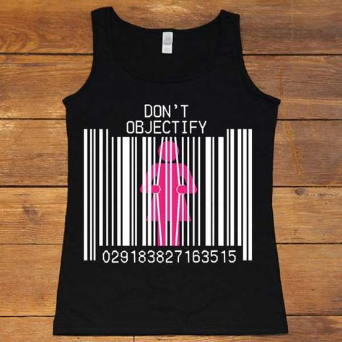

Slide 23
Statement
“Media and popular culture influences the way we view gender and sexuality!”

Slide 24
Language and Jokes

Slide 26
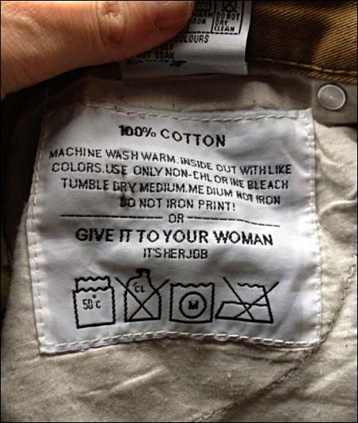

Slide 27
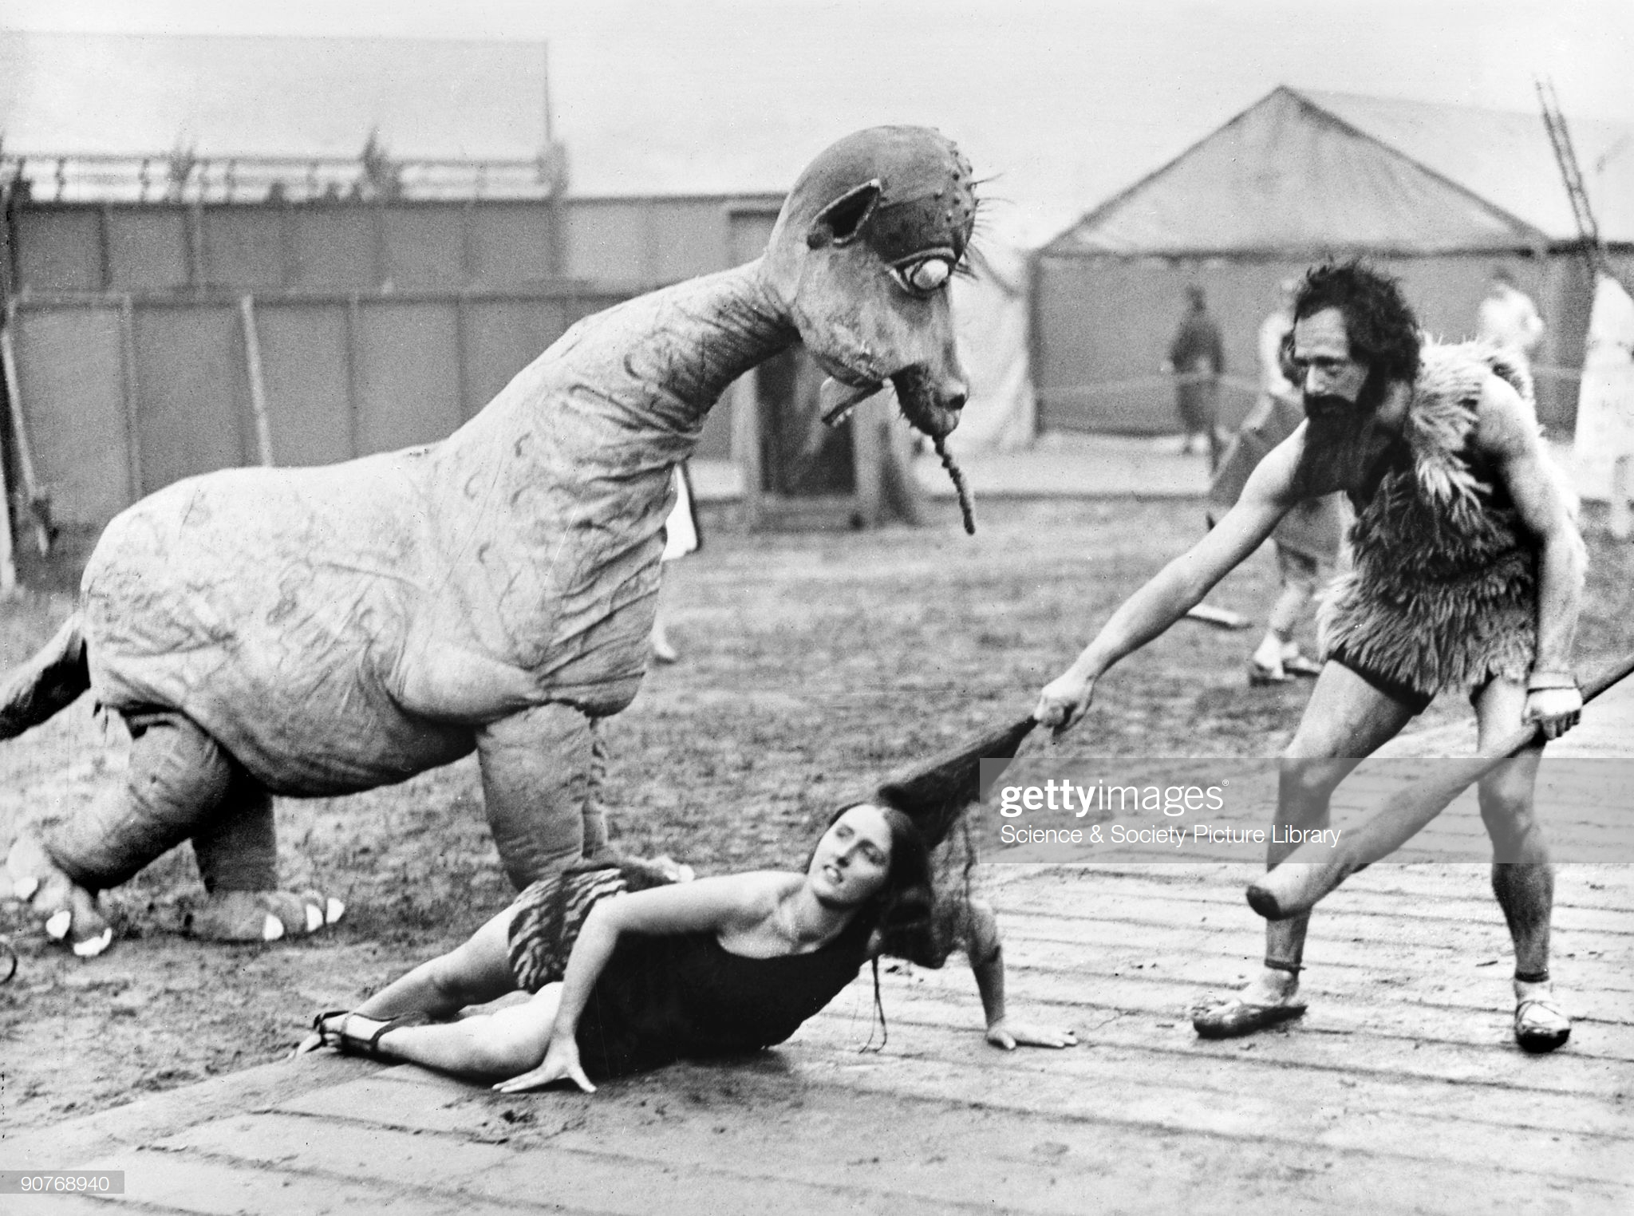

Slide 28
A kid asks his dad, "What's a man?" The dad says, "A man is someone who is responsible and cares for their family." The kid says, "I hope one day I can be a man just like mom!"

Slide 29
Statement
“It’s ok to use words like “Bitch” and “Slut” if women use them!”

Slide 30
The Wrap Up
Please consider!!
What will be your take away commitment in behaviour change?
From todays session what would be one thing you do as a bystander?

Slide 31
Thankyou

