Slide 1
Closing the Gap for Aboriginal Eye Health in East Gippsland
East Gippsland Aboriginal Eye Health Partnership
Presenters:
Joshua Tuiono – Gippsland and East Gippsland Aboriginal Co-operative
Jaquie Nethercote – East Gippsland Primary Care Partnership

Slide 2
Acknowledgment of Country
We would like to acknowledge the Yorta Yorta people as the traditional owners of the land on which we are presenting on today. We recognise and respect their cultural heritage, beliefs and relationship with the lands. We pay respect to the Elders Past, Present and Emerging. We would also like to pay our respect to all Aboriginal people here with us today and who have lived on this beautiful country for many generations.
Notes:
We would like to acknowledge the Yorta Yorta people as the traditional owners of the land on which we are presenting on today. We recognise and respect their cultural heritage, beliefs and relationship with the lands. We pay respect to the Elders Past, Present and Emerging. We would also like to pay our respect to all Aboriginal people here with us today and who have lived on this beautiful country for many generations

Slide 3
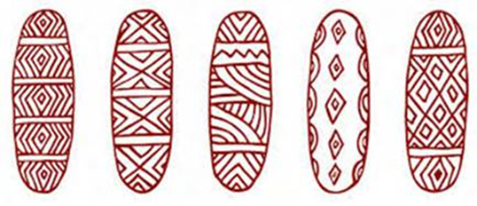
Who we are
The East Gippsland Aboriginal Eye Health Partnership (EGAEH) is a collaboration between:
Gippsland & East Gippsland Aboriginal Cooperation(GEGAC)
Lakes Entrance Aboriginal Health Association
Lake Tyers Health and Children's’ Services
Moogji Aboriginal Council
VACCHO
Bairnsdale Regional Health Service, including ophthalmology clinics
Orbost Regional Health
Gippsland PHN (GPHN)
Vision Australia
Department of Health and Human Services
Australian College of Optometry (ACO)
Consultant optometrists
Indigenous Eye Health, Melbourne University
Supported by East Gippsland Primary Care Partnership (EGPCP)
Notes:
The East Gippsland Aboriginal Eye Health Partnership is a collaboration between 4 local ACCHOs, VACCO, local health organisations, Vision Australia, Department of Health and Human Services, Australian College of Optometry, Consultant optometrists and Melbourne University.

Slide 4
Background
The initial idea
Nationally, despite Indigenous kids < 15 years having less vision problems than non-indigenous kids, Aboriginal and Torres Strait Islander adults experience 3 times higher rates of blindness and vision loss than non-Indigenous Australians
The main causes of vision loss in Aboriginal and Torres Strait Island communities in Victoria are largely preventable or treatable
Regional work is happening around the country to address the barriers that lead to this gap
Group was established in 2017 to look at pathways of care and identify any gaps and issues for Aboriginal and Torres Strait Islander people in the East Gippsland region
Notes:
Nationally, despite Indigenous kids < 15 years having less vision problems than non-indigenous kids, Aboriginal and Torres Strait Islander adults experience 3 times higher rates of blindness and vision loss than non-Indigenous Australians
The main causes of vision loss in Aboriginal and Torres Strait Island communities in Victoria are largely preventable or treatable (uncorrected refractive error, cataract, diabetic eye disease)
Regional work is happening around the country to address the barriers that lead to this gap
Group was established in 2017 to look at pathways of care and identify any gaps and issues for Aboriginal and Torres Strait Islander people in the East Gippsland region
Conversations started in 2016. The initial idea was pitched by Indigenous Eye Health (Uni Melbourne), VACCHO and the Australian College of Optometry (ACO.
Over the course of 2 years, they meet with our ACCHOs, DHHS, EGPCP and local hospitals, with the partnership slowly gathering momentum.
From then the partnership has grown with other stakeholders invited to participate including the ACO, VACCHO, the GPHN.
The partnership now includes 33 people representing 13 organisations.

Slide 5
Approach
Aim: To improve eye health outcomes for Aboriginal people in the region.
Put the word out for anyone who was interested in being a part of the partnership.
Provided a forum for the 4 local ACCHOS and other partners to map the journey of Aboriginal people in East Gippsland through all stages of eye health, screening and treatment.
Data was gathered using the University of Melbourne’s template.
Obtained data was used to identify gaps and challenges for eye care.
Notes:
Aim: To improve eye health outcomes for Aboriginal people in the region.
We put a call out to people that maybe interested in being a part of the partnership.
We then gathered the data based on the University of Melbourne’s template in partnership with agencies to identify where we had strengths and where the patient journey could be improved.

Slide 6
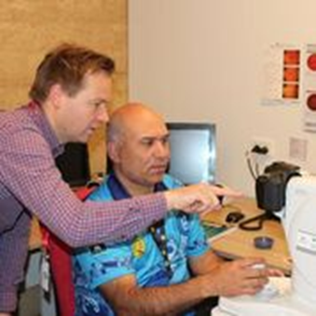
Challenges
Staff turn over
Getting everyone around the table
Collection of data
Coordination of pathways
Engaging eye health care services in the importance of Aboriginal eye health
Notes:
Staff turn over
Getting everyone around the table
Collection of data
Coordination of pathways
Engaging eye health care services in the importance of Aboriginal eye health

Slide 7
Things that have allowed us to work well
Cooperation of partnership
Commitment of ACCHOs
Willingness of local hospital to explore getting ophthalmologist on site
Commitment of local hospital to improving access for Aboriginal patients
Support of the PCP for secretariat
Notes:
Cooperation of partnership
Commitment of ACCHOs
Willingness of local hospital to explore getting ophthalmologist on site
Commitment of local hospital to improving access for Aboriginal patients
Support of the PCP for secretariat

Slide 8
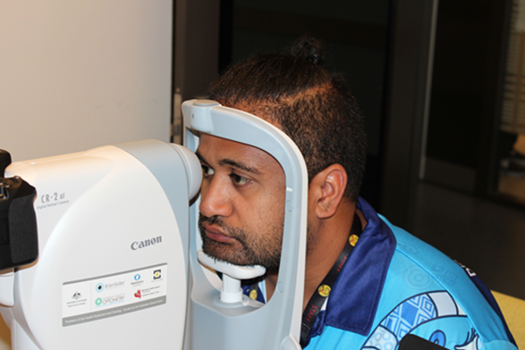
Outcomes
Good level of preventative eye health across the region
Minimised some gaps in the treatment end and the distances people have to travel for care by getting an ophthalmologist working at the local hospital and providing additional treatments
Have linked with state-wide and national strategies in Aboriginal eye health.
Utilising technology to enable collaboration of a diverse range of participants with meetings attended by those from Melbourne to Orbost and beyond
Notes:
We identified that we had quite a good level of preventative eye health across the region, with through connections between ACCHOs and optometrists or utilisation of the ACO visiting optometrist scheme.
There were larger gaps in the treatment end, with people often heaving to travel to Melbourne to receive services.
Have linked with state-wide and national strategies in Aboriginal eye health.
Good level of preventative eye health across the region
Minimised some gaps in the treatment end and the distances people have to travel for care by getting an ophthalmologist working at the local hospital and providing additional treatments
Have linked with state-wide and national strategies in Aboriginal eye health.
Utilising technology to enable collaboration of a diverse range of participants with meetings attended by those from Melbourne to Orbost and beyond

Slide 9
Key achievements
Identified areas for improvement in the local person’s eye care journey
Raised the profile of diabetes and diabetes related eye exams with local practitioners
Contributed to conversations about service coordination between Aboriginal and mainstream services
Have brought ocular injections to Bairnsdale – enabling people to access a local service instead of traveling to broader Gippsland or Melbourne.
Supported local eye health promotion events
Developed local resources with local Aboriginal people on them
Supported local Aboriginal health organisations who have recently received retinopathy camera to screen people
Presented at Alice Springs Close the Gap for Vision 2019 Conference
Notes:
Identified areas for improvement in the local person’s eye care journey
Raised the profile of diabetes and diabetes related eye exams with local practitioners
Contributed to conversations about service coordination between Aboriginal and mainstream services.
Have brought ocular injections to Bairnsdale – enabling people to access a local service instead of traveling to broader Gippsland or Melbourne.
Supported local eye health promotion events.
Developed local resources with local Aboriginal people on them.
Supported local Aboriginal health organisations who have recently received retinopathy camera to screen people.

Slide 10
Looking into the Future – Eye Health Promotional event
Held at Gippsland and East Gippsland Aboriginal Cooperative (GEGAC)
In 2017 received a retinal camera from funding provided by The Provision of Eye Health Equipment and Training Program co-led by Brien Holden Vision Institute and the Australian College of Optometry
9 staff have since been trained by The Australian College of Optometry in using the camera
In 2018 wanted to increase the camera use so held a community day
Day consisted of yarning, education, eye health screenings, games and a movie
Results from the day suggested good community engagement and increased awareness of the availability of the retinal camera
Notes:
GEGAC identified as a site that would benefit from receiving eye health equipment and received a Retinal Camera provided by The Provision of Eye Health Equipment and Training Program co-led by Brien Holden Vision Institute and the Australian College of Optometry
Training on the camera was delivered by The Australian College of Optometry. So far 9 staff have been trained.
In 2018 we wanted to increase the use of the camera and held a community day. The community day was funded by GEGAC and Melbourne University.
Our target group for the day was Aboriginal people who have diabetes.
The day consisted of yarning, education, eye health screenings, games and a movie.
Results from the day suggested good community engagement and increased awareness of the availability of the retinal camera.

Slide 11
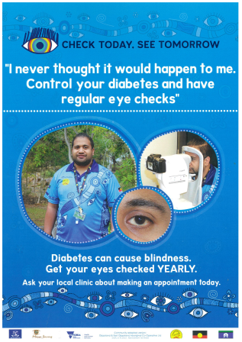
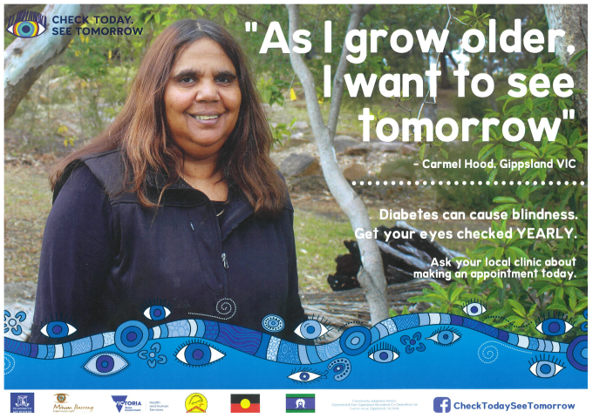
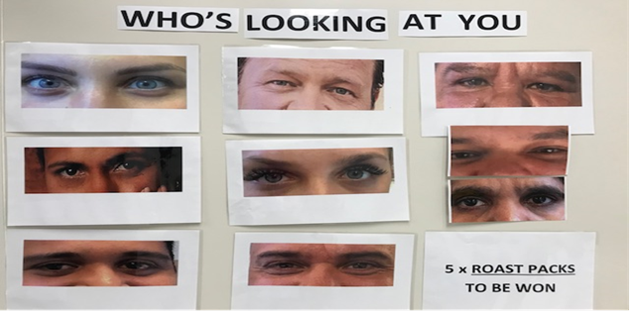
Examples of games and promotional material.
Who’s looking at you? Designed by GEGAC
Promotional material with local Aboriginal people on them – Posters funded by Department of Health and Human Services Victoria, through Melbourne University

Slide 12
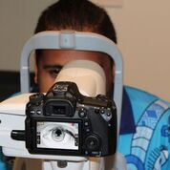
Where to next?
More clarity on pathways
Working out how to make better connections between the services and service providers where needed
Creating sustainable pathways for short term projects
Considering education on “asking the question” for local service providers
Notes:
More clarity on pathways
Creating sustainable pathways for short term projects, for example the visiting IDEAS Van.
Considering education on asking the question for local service providers.

Slide 13
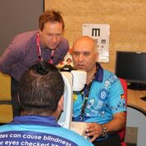
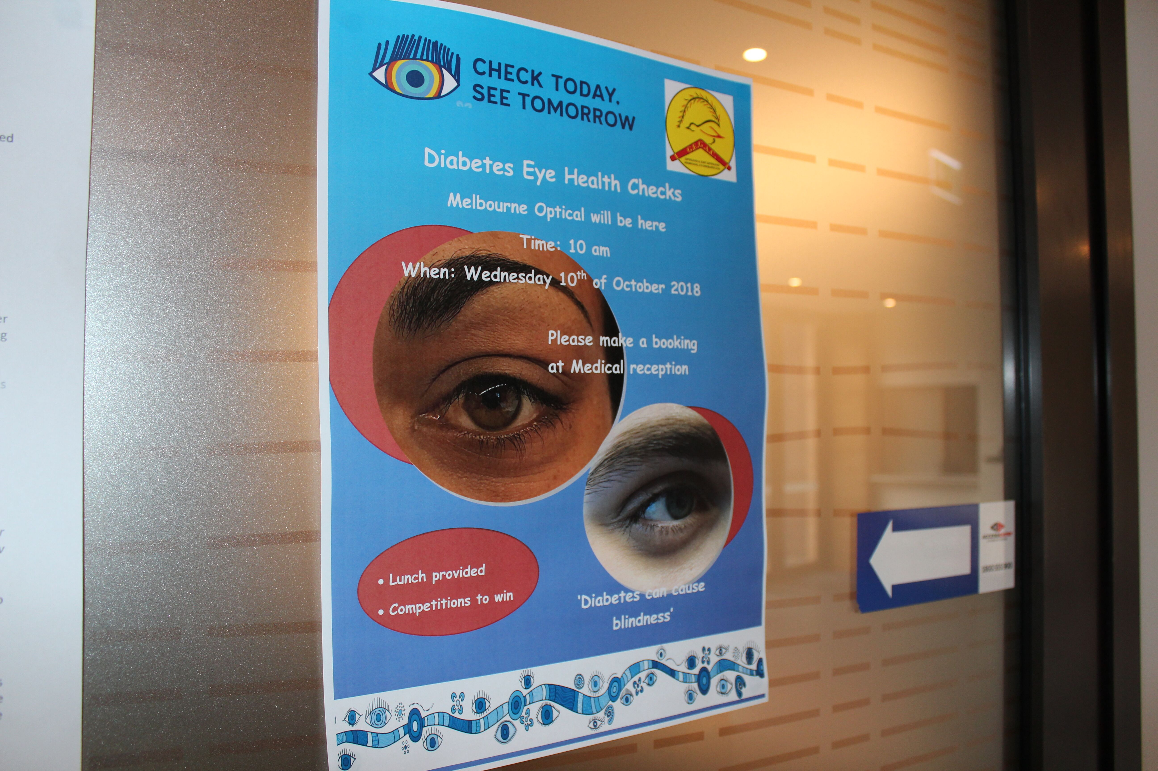
Questions?

Slide 14
Thank you
Thank you for attending our presentation
Thank you to the Yorta Yorta people for hosting us today
Thank you to the members of the East Gippsland Aboriginal Eye Health partnership:
Gippsland & East Gippsland Aboriginal cooperation
Lakes Entrance Aboriginal Health Association
Lake Tyers Health and Children's’ Services
Moogji Aboriginal Council East Gippsland
VACCHO
Gippsland Primary Health Network
Bairnsdale Regional Health Service
Orbost Regional Health
Indigenous Eye Health, Melbourne University
Vision Australia
Australian College of Optometry
Eat Gippsland Primary Care Partnership
Department of Health and Human Services

